Slide 1

G. H. RAISONI COLLEGE OF ENGINEERING AND MANAGMENT
An Empowered Autonomous Institute Affiliated to SPPU
DEPARTMENT - ARTIFICIAL INTELLIGENCE
SIGN LANGUAGE RECOGNITION SYSTEM USING
DEEP LEARNING
S
TEAM MEMBERS:
ADITI KANNAWAR (A04)
PRANALI PATIL ( A41)
RANI MANWAR (A47)
TANAY MAPARE(A75)
GUIDE : PROF. SONALI SONAWANE
Notes:
From Here Shweta

Slide 2

CONTENTS
Introduction
Literature Survey
Problem Statement
Motivation
Objective
Working
Convolutional neural network
Result
Approach
Conclusion
Future Scope
Reference

Slide 3
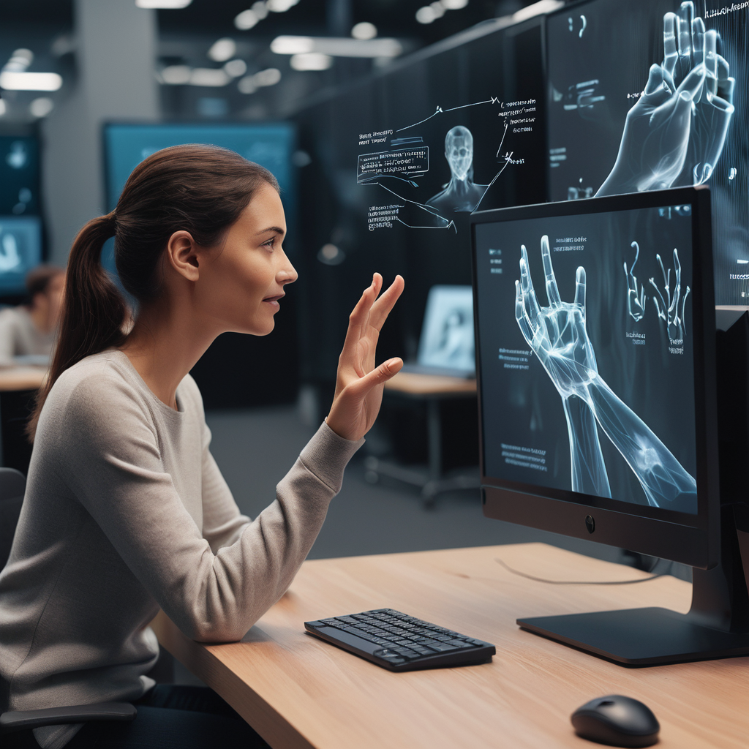
INTRODUCTION
The world hardly lives without communication, no matter whether it is in the form of text, voice or visual expression.
The communication among the deaf and dumb people is carried by text and visual expressions.
Sign language is a visual means of communication for individuals who are deaf or hard of hearing.
Deep learning, a subset of artificial intelligence, offers promising solutions for sign language detection

Slide 4
LITERATURE SURVEY
Paper Name | Author Name | Methodology | Advantages | Disadvantages | Future Work
Sign Language Recognition in the Hindi Language Based on Computer Vision | Dr. Chhaya Grover Avni Rajpoot Aditya Verma Ayush Patel | Deep learning with CNNs and RNNs including preprocessing techniques . | Aims to translate sign language into Hindi, improving communication for speech-impaired individuals. | Limitation: Need larger, diverse Hindi sign dataset; challenges in real-time recognition. | Expand dataset, improve accuracy, recognize words, translate to Hindi.
Hindi Sign Language Detection Using CNN | Prof. Pragya Sinha Ifham Khwaja Kaushik Rathod Naman Sanklecha | Data collection, OpenCV sign detection, preprocessing, CNN training, evaluation. | Improves communication for deaf and mute people, facilitating education and social interaction. | Concerns: Accuracy, equipment, lack of diverse training data hinder development. | Accuracy improvement, language coverage, real-time implementation, user interface, collaboration.
Indian Sign Language Recognition using Convolutional Neural Network | Rachana patil Vivek Patil Abhishek Bahuguna Mr. Gaurav Datkhile | Image acquisition, segmentation, CNN training for Indian Sign Language. | Enhanced communication, accessibility, tech innovation, autonomy. | Model limitations: cultural sign variations, predicting image names, potential unaddressed issues. | Enhance image processing, enable bidirectional communication, real-time interpretation.

Slide 5
Paper Name | Author Name | Methodology | Advantages | Disadvantages | Future Work
Sign Language Recognition using Convolutional Neural Network with Customization | Heramba Limaye Shraddha Shinde Anurag Bapat Nimish Samant | Data collection, preprocessing, CNN building, GUI, real-time accuracy evaluation.. | Real-time processing, feature extraction, and spatial correlation utilization. | Document lacks CNN disadvantages; notes incremental learning challenges for accuracy. | Future research: mitigate accuracy decline, alternative learning, advanced computer vision.
Gesture Recognition Based on a Convolutional Neural Network–Bidirectional Long Short-Term Memory Network for a Wearable Wrist Sensor with Multi-Walled Carbon Nanotube/Cotton Fabric Material | Yang Song, Mengru Liu, Feilu Wang, Jinggen Zhu Anyang Huand Niuping Sun | Steps: fabricate sensors, integrate into wristband, collect gestures, CNN-BiLSTM, test accuracy. | Flexible, sensitive pressure sensor from MWCNT/CF composite, integrated into a wristband for accurate gesture recognition. | Challenges: Limited gesture coverage, real-world applicability, scalability, comparative analysis. | Advancements: HCI, health monitoring, assistive tech, smart textiles, industrial applications.
Sign Language Recognition System Using Deep Neural Network | Surejya Suresh Mithun Haridas T.P. Supriya M.H | Method: 2-layer CNN for sign language classification using Python libraries. | TIdentifies six sign languages, utilizes deep learning, achieves high accuracy, and enables real-world device control. | Document lacks discussion on drawbacks or challenges of CNN implementation. | Enhance performance, video recognition, integrate with device control for sign language.

Slide 6
Paper Name | Author Name | Methodology | Advantages | Disadvantages | Future Work
A Static Hand Gesture Based Sign Language Recognition System using Convolutional Neural Networks | Diksha Hatibaruah Anjan Kumar Talukdar Kandarpa Kumar Sarma | Hand segmentation, dataset creation, CNN design, training/testing, live testing, evaluation. | High accuracy, real-time output, and customizable dataset. | Limitations: lighting, static gestures, computational time, background, Indian Sign Language. | Advance CNNs for dynamic gestures, diverse sign languages, lighting, translation.
Mudra: Convolutional Neural Network based Indian Sign Language Translator for Banks | Gautham Jayadeep Vishnupriya N V Vyshnavi Venugopal Vishnu S Geetha M | Method: Hand segmentation, dataset creation, CNN design, training, live testing, evaluation. | aims to bridge the communication gap between the deaf-mute community and banks using deep neural network models and demonstrating the effectiveness of advanced technology | Complexity of Indian Sign Language presents challenges in gesture recognition. | Expand dataset, add sentences, automate, add text-to-speech, explore models.
SIGN LANGUAGE RECOGNITION FOR HINDI VARNAMALA USING CNN | Pratibha Gupta Priya Rajput Priyanka Katiyar Srishti Sharma Shaivya Shukla Dr. Umesh Dwivedi | Create dataset, train CNN, predict, deploy as web application. | Hindi sign language fosters unity, understanding, bridges communication in India. | Expand dataset, improve accuracy, ongoing refinement for effective ISL recognition. | Improve accuracy, expand dataset, commercialize for broader adoption.

Slide 7
Paper Name | Author Name | Methodology | Advantages | Disadvantages | Future Work
A Multitask Sign Language Recognition System Using Commodity Wi-Fi | Zhongjian Gao Chien-Cheng Lee Lianhui Zheng Ruige Zhang Xiaofu Xu1 | Wi-SignFi: CSI data, eight-layer CNN, KNN for multitask recognition. | Wi-Fi sensing: wide range, less privacy concerns, cost-effective, easy deployment. | Accuracy influenced by input resolution, lightweight CNN may capture limitations. | Integrate IoT, capture dynamics, explore sensing, embed real-time applications.
Dynamic Sign Language Recognition Based on CBAM with Autoencoder Time Series Neural Network | Yanglai Huang , Jing Huang , Xiaoyue Wu Yu Jia | Utilize convolutional self-coding network with CBAM for recognition, including preprocessing. | Method improves accuracy (89.90%) and generalization via continuous sample expansion. | Limitations: monotonous input, lack of optical flow, multimodal fusion. | Fuse multimodal data, advance neural architectures for better recognition accuracy.
Improved Recognition of Kurdish Sign Language Using Modified CNN | Karwan Mahdi Hama Rawf Ayub Othman Abdulrahman Aree Ali Mohammed | CNN architecture achieves high accuracy for Kurdish sign letter recognition. | KuSL system: 98.8% accuracy aids Kurdish deaf community, fostering independence. | Concerns: overfitting, real-time execution, intricate contexts, optimization, technology integration. | Enhance real-time, handle complexity, expand vocab, promote inclusivity through tech.

Slide 8
PROBLEM STATEMENT
The desire for a computer-based solution is significant in this age of technology for deaf people. However, researchers have been working on the problem for quite some time, and the results are promising. Although interesting technologies for voice recognition are becoming available, there is currently no commercial solution for sign recognition on the market.
The gesture is a vital and meaningful mode of communication for the deafperson. So here is the computer-based method for regular people to understand what the differently-abled individual is trying to say.In our system, the user will perform the hand gestures or signs by turning on their camera, and the system will detect the sign and display it to the user.
Notes:
From Here Shabista

Slide 9
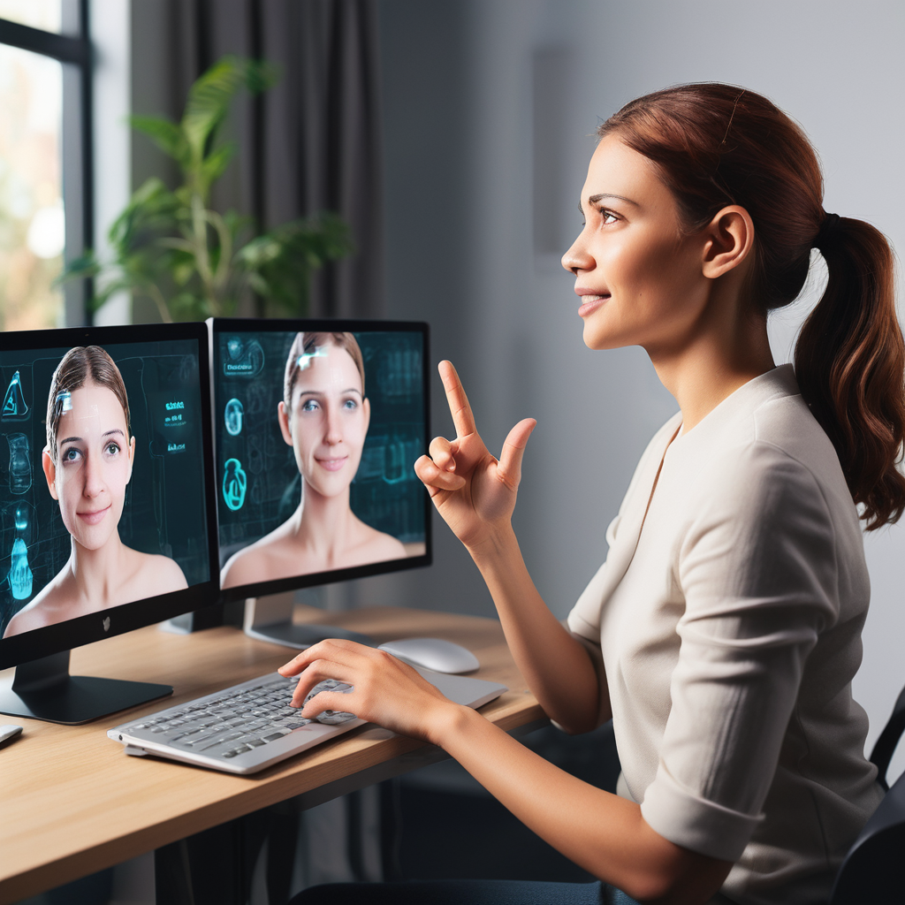
MOTIVATION
Sign language is learned by deaf and dumb, and usually it is not known to normal people, so it becomes a challenge for communication between a normal and hearing impaired person.
Its strike to our mind to bridge the between hearing impaired and normal people to make the communication easier.
Sign language recognition (SLR) system takes an input expression from the hearing impaired person gives output to the normal person in the form of text.

Slide 10
OBJECTIVES
Communication is always having a great impact in every domain and how it is considered the meaning of the thoughts and expressions that attract the researchers to bridge this gap for every living being.
The objective of this project is to identify the symbolic expression through images so that the communication gap between a normal and hearing impaired person can be easily bridged.
Notes:
Till Here Shweta

Slide 11
WORKING
Dataset Collection: Collected data for each sign from A to Z using collectdata.py. Thirty images were collected for each sign and stored in the MP_Data folder.
Data Preprocessing: Standardize the input data to a uniform scale by rescaling all images to the same dimensions. Extract regions of interest, specifically the hands, from the images.
Model Training: Utilize a LSTM-based neural network to capture temporal dependencies within the preprocessed data and implement the model using TensorFlow and Keras.

Slide 12
Model Evaluation: Evaluate the model performance using metrics such as accuracy, precision, recall, and F1-score. Split the dataset into training and validation sets to assess the model's generalization ability.
Real-Time Gesture Recognition: Utilize OpenCV to capture real-time video feed, pass the frames through the trained LSTM model, and display recognized gestures along with confidence levels on the screen.
Deployment: Deploy the model in a real-world application

Slide 13
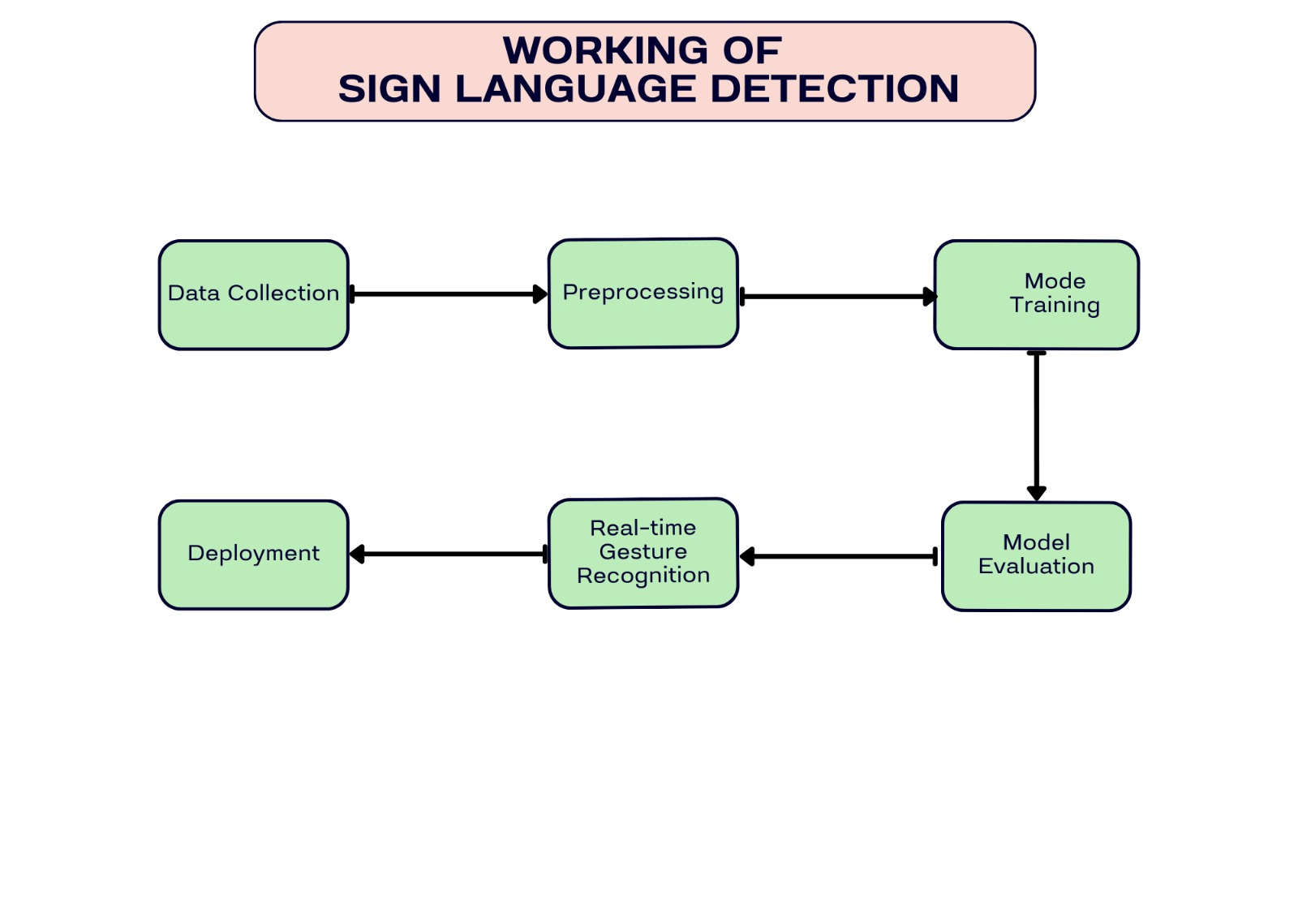

Slide 14

CONVOLUTIONAL NEURAL NETWORK

Slide 15
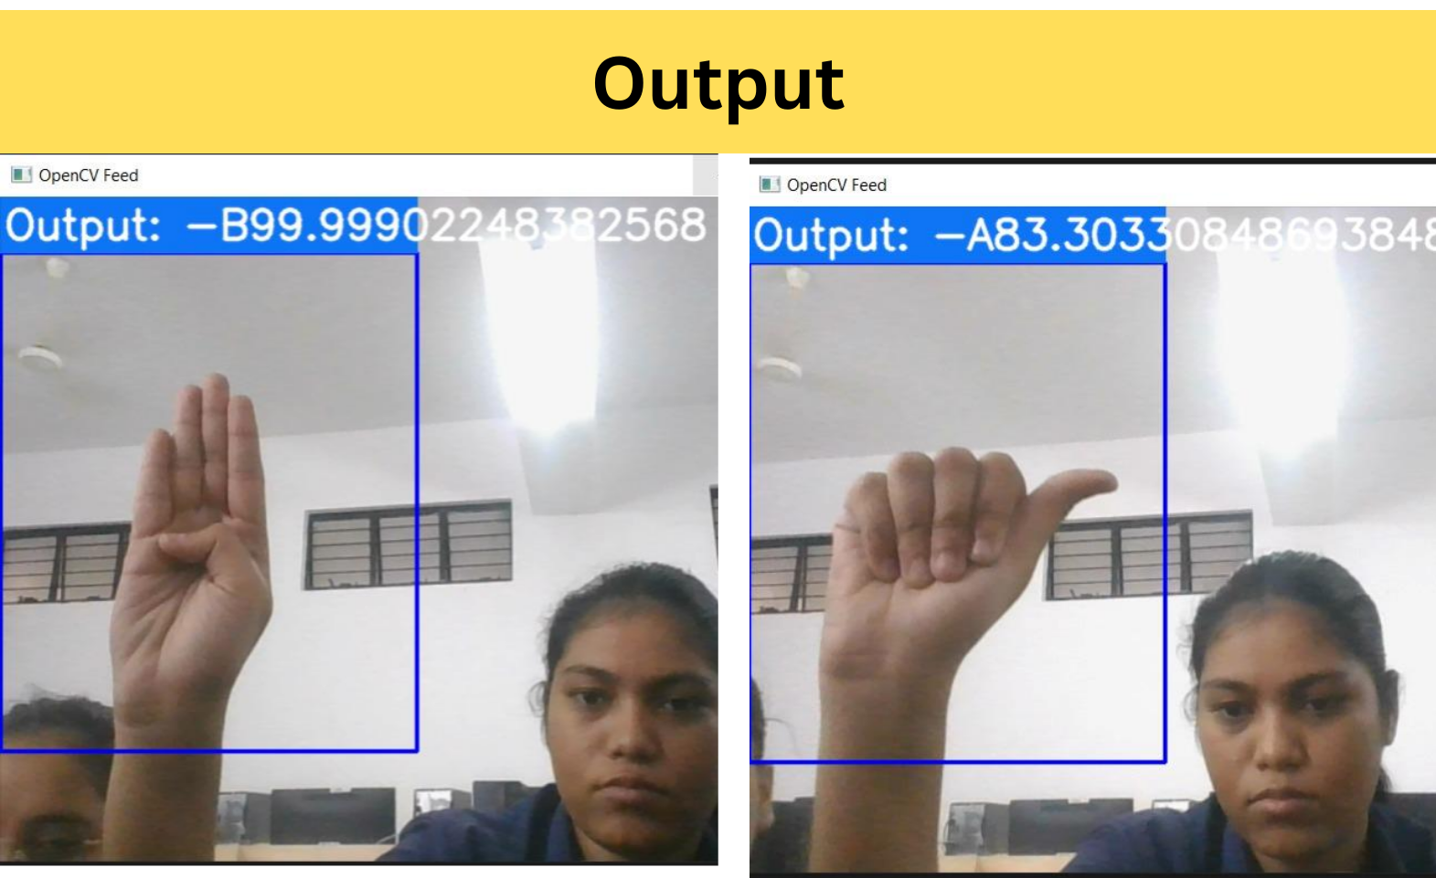
RESULT
The proposed deep learning model performed well, achieving approximately 97% accuracy on 24 different symbols representing English letters (ISL) in video frames.
This remarkable fact demonstrates a good standard of knowledge in detecting and identifying characters based on human movements.
This decision is important to reduce communication problems for people with speech or hearing disabilities. Self-sufficiency in every situation.

Slide 16
APPROACH
The approach of a sign recognition system involves various methods such as vision-based and wearable sensing modalities like sensory gloves, deep learning models, and the fusion of image and hand data. These approaches aim to recognize both static and dynamic signs in sign language.
Vision-based techniques utilize images, sensor data, and videos for recognition, while deep learning models like YOLOv6 are employed for American Sign Language (ASL) recognition. Additionally, the fusion of image and hand data is crucial for accurate sign language recognition, especially in noisy environments where pre-processing is essential.
Notes:
Till Here Shabista

Slide 17
CONCLUSION
In this project, we proposed an idea for feasible communication between hearing aring impaired and normal person with the help of deep learning and machine learning approach.
This proposed work ensures the accuracy of 91.22% using SVM, 95.71% using Random Forest, 87.54% using KNN. 98.74% using CNN and 99.79 using AlexNet.
There is ever the sounding challenge to develop a sign language system in data the collection remains invariant of the unconstraint environment. This project can be extended to the real time data

Slide 18
Future Scope
Improved Accuracy and Robustness
Multi-modal Fusion
Adaptation to User Preferences
Real-world Applications

Slide 19
REFERENCES
[1] M. Elmezain, A. Al-Hamadi, and B. Michaelis, Real-Time Capable System for Hand Gesture Recognition Using Hidden Markov Models in Stereo Color Image Sequences, The Journal of W S C G’08, Vol. 16(1), pp. 65-72, 2008
[2] Prateek Bhatia (2019) Sign Language Recognition Systems: A Decade Systematic Literature Reviewhttps://www.researchgate.net/pu blication/353571514
[3] ADEYANJU, I.A., BELLO, O.O. and ADEGBOYE, M.A.(2021),”Machine learning methods for sign language recognition”,https://doi.org/10.1016/j.iswa .2021.200056
[4] Md.Zahirul Islama and Md.Shahadat Hossain, "Static Hand Gesture Recognition " 2019 IEEE International Conference paper, doi: 10.1109/ICIEV.2019.8858563.
[5] Mukesh Kumar Makwana, ”Sign language recognition using convolutional neural networks.” 2014.

Slide 20
[6] Dr. Chhaya Grover Avni Rajpoot Aditya Verma Ayush Patel, “Sign Language Recognition in the Hindi Language Based on Computer Vision”, The Journal of W S C G’08, Vol. 16(1), pp. 65-72, 2020
[7] Prof. Pragya Sinha Ifham Khwaja Kaushik Rathod Naman, “Hindi Sign Language Detection Using CNN”
2020 IEEE International Conference paper, doi:10.1109/ICIEV.2019.8858563.
[8] Rachana patil Vivek Patil Abhishek Bahuguna Mr. Gaurav Datkhile,”Machine learning methods for sign language recognition”,https://doi.org/10.1016/j.iswa .2021.200058
[9] Heramba Limaye Shraddha Shinde Anurag Bapat Nimish Samant, "Sign Language Recognition using Convolutional Neural Network with Customization " 2021 IEEE International Conference paper, doi: 10.1109/ICIEV.2019.8857563.
[10] Pratibha Gupta Priya Rajput Priyanka Katiyar Srishti Sharma Shaivya Shukla Dr. Umesh Dwivedi, ”Sign language recognition using convolutional neural networks.” 2019.

Slide 21
[11] Zhongjian Gao Chien-Cheng Lee Lianhui Zheng Ruige Zhang Xiaofu Xu1, “A Multitask Sign Language Recognition System Using Commodity Wi_x0002_Fi”, The Journal of W S C G’08, Vol. 16(1), pp. 65-72, 2019
[12] Shital Pawar, Yashashree Shastri, Syeda Zarah Aiman, "Bidirectional Sign Language Assistant with MediaPipe Integration", 2024 International Conference on Emerging Smart Computing and Informatics (ESCI), pp.1-8, 2020

Slide 22
THANK YOU
Notes:
Till Here Prishita

